Slide 1
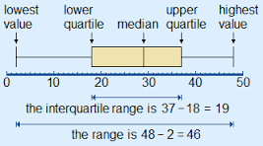
Quick Revision Label the box and whisker plot

Slide 2
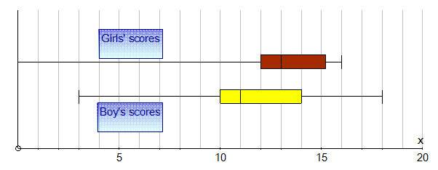
A Teacher was comparing the girls and the boys results on a recent test. By looking at the box and whisker plots, who did better?
Notes:
Hook
Run a philosophical chairs with the class.
Think about your answer
Write down your answer with reasons why

Slide 3
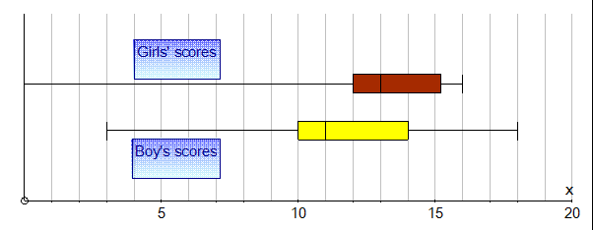
If you think Boys did better go to the door side, If you think the girls did better go to the window side
Why have you chosen where you are standing?

Slide 4
24
7
30
Date
Comparing data
EQ – How can we use box and whisker plots to compare data?
What does the 5 number summary tell us?
Lowest score: The smallest score
Lower Quartile (Q1): the first quartile means that ¼ of the class scored below this score
Median (Q2): The median is the middle, so ½ the class scored above this and ½ below
Upper Quartile (Q3): The upper quartile has ¾ of the scores below it and ¼ above it
Highest score: The biggest score
5
Notes:
Lesson objective (EQ)

Slide 5
Boys | Girls
Lowest: 3 Q1: 10 Med: 11 Q3: 14 Highest: 18 | Lowest: 0 Q1: 12 Med: 13 Q3: 15.25 Highest: 16
Notes:
Guided practice

Slide 6
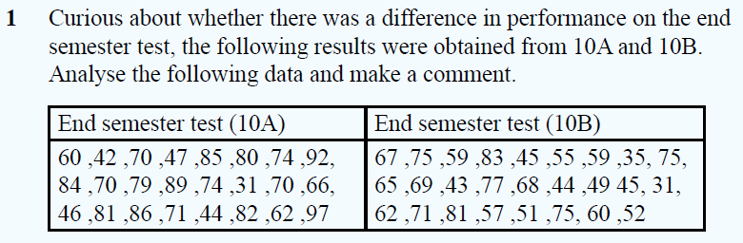
Construct the box and whisker plots
Write a paragraph explaining which test has the better results and why
Notes:
Check for understanding

Slide 7
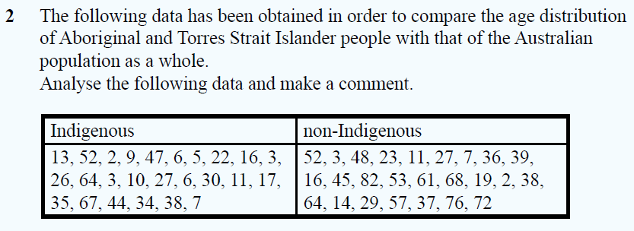
Construct the box and whisker plots
Write a paragraph explaining which test has the better results and why
Notes:
Independent practice

Slide 8
How can a Graphical display be better than using the mean when comparing data?
Think
Pair
Share
Notes:
Closure

